Slide 1
Mini Project
(mid sem evaluation)
Topic: SuppliChain
(Revolutionizing Supply Chain with Blockchain)
Presented by:
Minav Karia - 16010122083
Romil Lodaya - 16010122096
Sanika Lunawat - 16010122098
Faculty Mentor: Prof. Poonam Bhogle

Slide 2
Introduction
Pharma-SupplyChain-Blockchain is a decentralized application that aims to reform the pharmaceutical supply chain. By integrating blockchain technology, it ensures that each drug batch is transparently and securely tracked throughout its lifecycle—from manufacturing to consumption. The system reduces fraud, improves accountability, and makes drug verification easily accessible.
Problem Statement:
The pharmaceutical supply chain faces several critical challenges, including inefficiency, lack of transparency, and the proliferation of counterfeit drugs.
These issues not only compromise patient safety but also lead to significant financial losses for pharmaceutical companies, distributors, and retailers.
Currently, centralized supply chain management systems are prone to fraud, errors, and operational delays, lacking a secure method to track and verify the movement of drugs from production to final delivery.

Slide 3
Introduction
Proposed Solution:
A decentralized pharmaceutical supply management system using blockchain technology to address these challenges.
Blockchain offers a secure, transparent, and tamper-proof ledger where each transaction is recorded and verified across multiple nodes, ensuring data integrity and authenticity.
By integrating blockchain with smart contracts, we can automate and enforce compliance in the supply chain, reducing human intervention and minimizing errors.

Slide 4
Motivation
The pharmaceutical industry faces a persistent threat from counterfeit and substandard drugs. According to the World Health Organization, around 1 in 10 medical products in developing nations is fake or below standard. These not only compromise patient safety but also lead to significant revenue losses and mistrust among consumers. Traditional supply chain systems are opaque and prone to manipulation, with no mechanism for real-time, end-to-end verification.
The motivation behind this project lies in the urgent need for a more trustworthy, verifiable, and tamper-proof system. Blockchain technology offers immutability and transparency, making it ideal for tracing the flow of goods in critical sectors like pharmaceuticals. The use of decentralized storage, such as IPFS, adds another layer of reliability for preserving sensitive records.
SDG Alignment:
Goal 3 – Good Health and Well-being: Ensures access to safe and verified medicines.
Goal 9 – Industry, Innovation, and Infrastructure: Promotes resilient infrastructure via decentralized tech.

Slide 5
Scope
Applications:
Pharmaceutical Supply Chain Management: Track and verify every stakeholder's role in a drug's journey.
Government and Regulatory Use: Enables easy auditing of drug movement and compliance.
Logistics Companies: Enhances logistics transparency in healthcare supply chains.
Retail and Pharmacies: Verify product origin and authenticity before sale to consumers.
Public Health Institutions: Monitor availability and distribution of essential medicines.
Limitations:
Relies on blockchain networks like Ethereum, which may have high transaction (gas) fees.
Learning curve for users unfamiliar with blockchain or wallet-based interactions.
Document verification is still semi-manual in the current implementation.
IPFS availability depends on network peers; not 100% guaranteed uptime.

Slide 6
Objectives
To design and implement a role-based supply chain using smart contracts on Ethereum.
To track and verify pharmaceutical batches as they pass through multiple parties.
To ensure transparency by storing drug data and logs on an immutable ledger.
To securely store documents and certifications using decentralized storage like IPFS.
To enable event-driven updates so that participants can respond to real-time supply changes.
To create a user-friendly interface for different roles like Manufacturer, Distributor, Retailer, and Customer.
To integrate off-chain and on-chain systems seamlessly using modern Web3 libraries.
To support auditability and openness, making it easier for third parties and regulators to monitor operations.

Slide 7
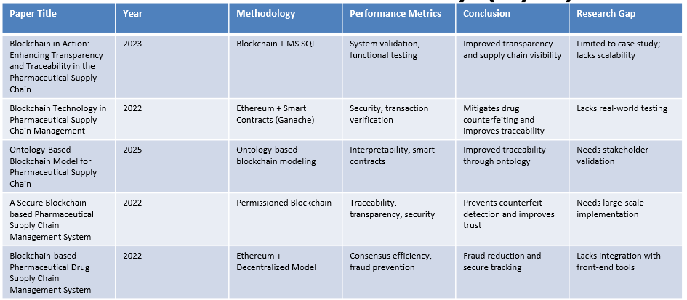
Literature Survey

Slide 8
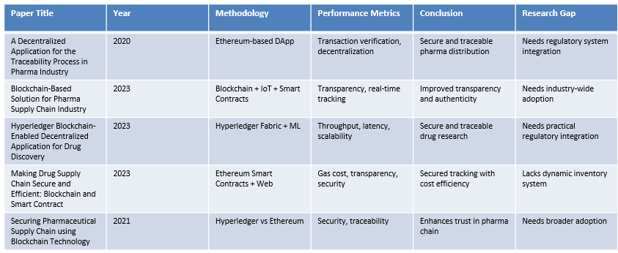
Literature Survey

Slide 9
Methodology
Users connect wallets and apply for specific roles
Backend verifies documents and requests via Express and MongoDB
Admin approves and assigns roles on-chain through smart contracts
Manufacturers create batches and store metadata on IPFS
Distributors and retailers perform secure, trackable transfers
Customers can view full traceability using batch IDs

Slide 10
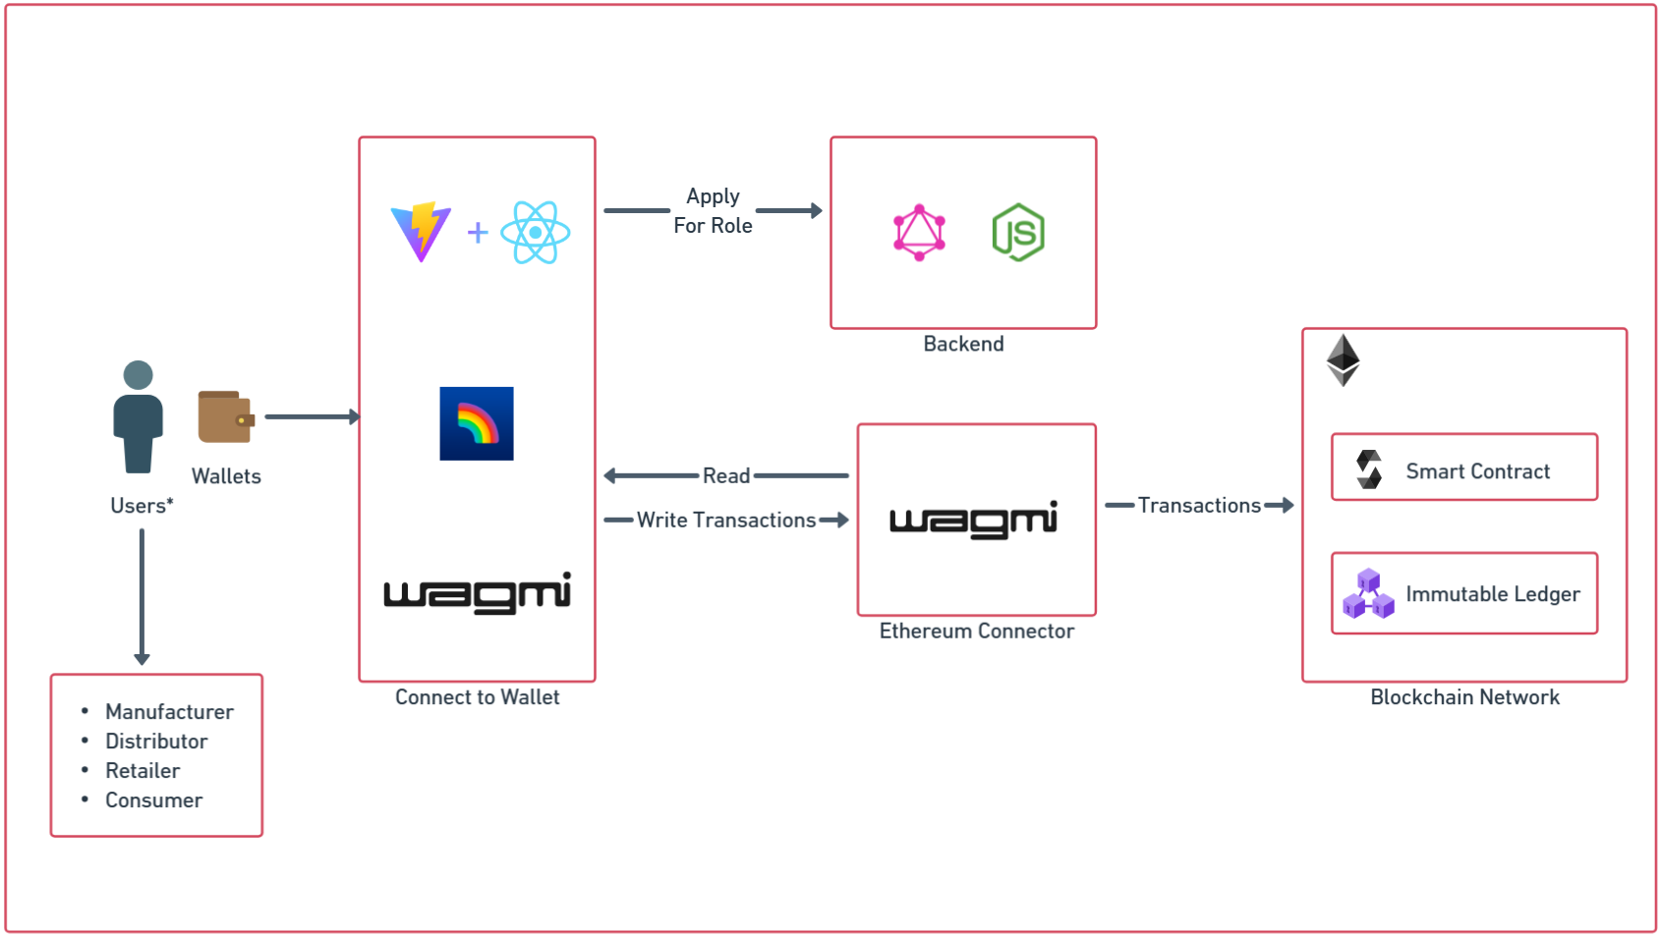
System Architecture Overview

Slide 11
Implementation
Smart contracts written in Solidity and tested via Remix and Hardhat
Role-based DApp UI built with React, TypeScript, Wagmi, and RainbowKit
Backend with Node.js, GraphQL APIs, and MongoDB for off-chain data
IPFS used for document storage with hash references in smart contracts
Deployed smart contract live on Ethereum testnet (Sepolia)
Role assignment, batch creation, and transfer features implemented
Events tracked for transparency and UI feedback

Slide 12
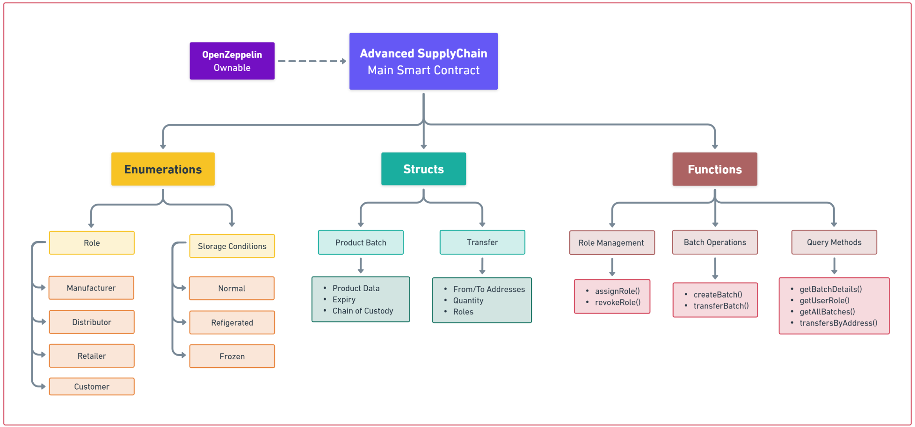
Smart Contract Architecture

Slide 13
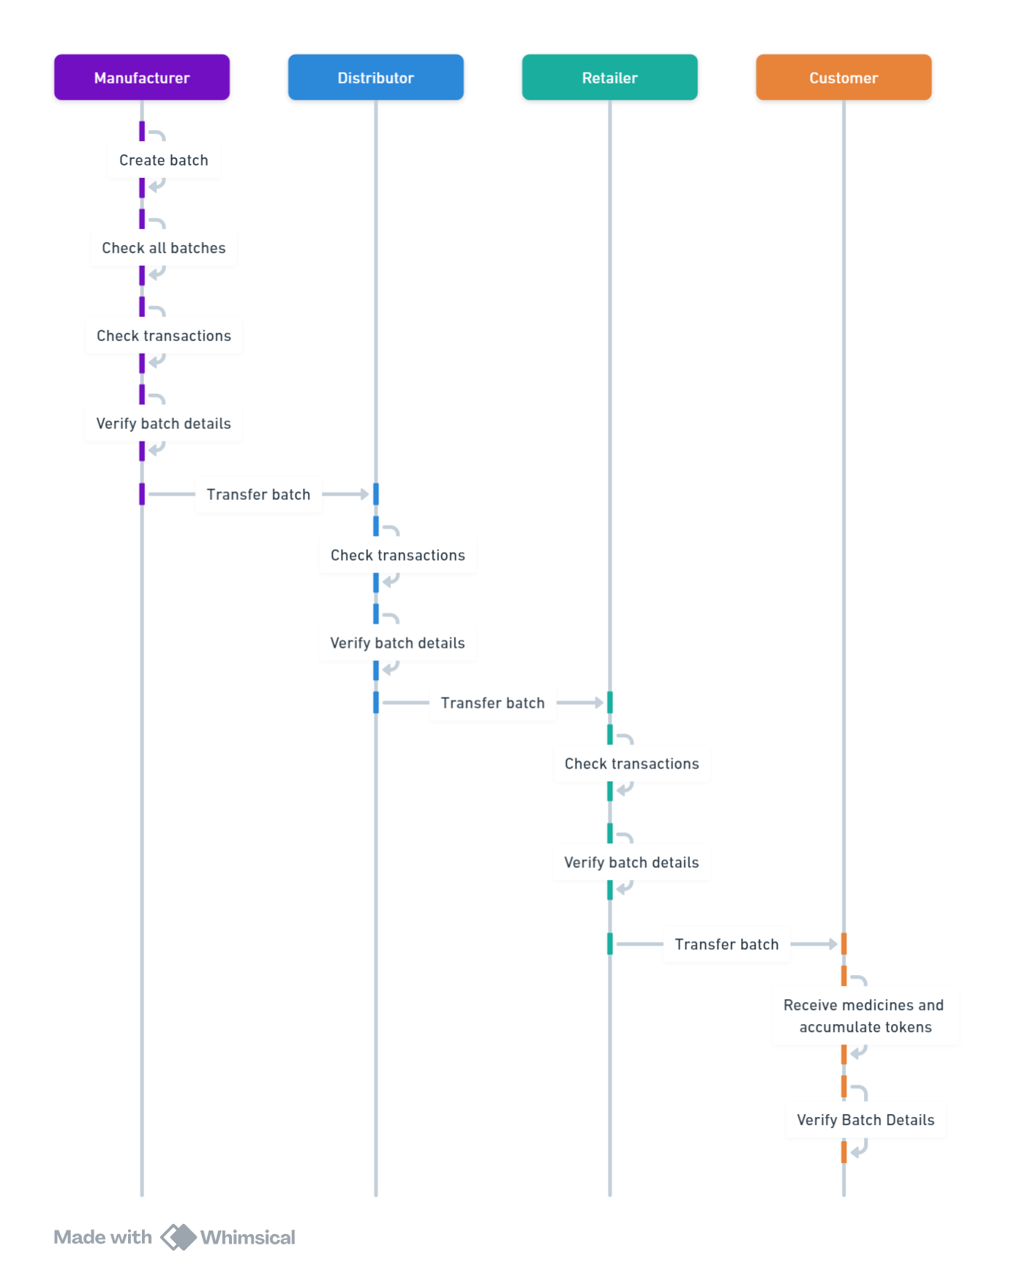
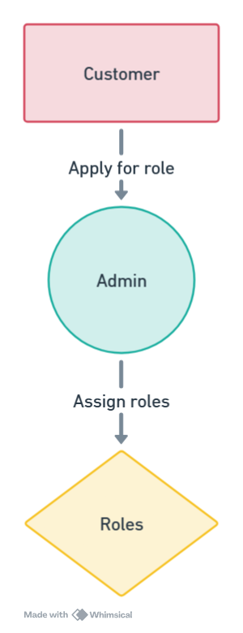
User Flow & Transactions Sequence

Slide 14
Conclusion
The project successfully showcases how blockchain can revolutionize supply chain transparency in the pharmaceutical sector.
Role-based access using smart contracts ensures authorized, traceable actions by each stakeholder.
By storing documents on IPFS and referencing them on-chain, the system achieves both scalability and decentralization.
Frontend technologies like RainbowKit and Wagmi enhance user experience in interacting with Web3 wallets.
Security, transparency, and trust are at the core of the system, directly addressing real-world problems like counterfeit medicine.
The architecture allows for future extensibility, including support for additional roles, automated audits, or cross-chain operability.

Slide 15
References
Brockman, P., French, D., & Tamm, C. (2014). REIT organizational structure, institutional ownership, and stock performance. Journal of Real Estate Portfolio Management, 20(1), 21–36.
Cella, C. (2009). Institutional investors and corporate investment. Indiana University, Kelley School of Business.
Dyakov, T., & Wipplinger, E. (2020). Institutional ownership and future stock returns: An international perspective. International Review of Finance, 20(1), 235–245.
McNulty, T., & Nordberg, D. (2016). Ownership, activism and engagement: Institutional investors as active owners. Corporate Governance: An International Review, 24(3), 346–358.
Shleifer, A., & Vishny, R. W. (1986). Large shareholders and corporate control. Journal of Political Economy, 94(3), 461–488.
Wooldridge, J. M. (2013). Econometric Analysis of Cross Section and Panel Data. MIT Press.
Ying, Q., Kong, D., & Luo, D. (2015). Investor attention, institutional ownership, and stock return: Empirical evidence from China. Emerging Markets Finance & Trade, 51(3), 672–685.
Zou, H., & Adams, M. B. (2008). Corporate ownership, equity risk and returns in the People's Republic of China. Journal of International Business Studies, 39(7), 1149–1168.
Han, K.C., & Suk, D.Y. (1998). The effect of ownership structure on firm performance: Additional evidence. Review of Financial Economics, 7(2), 143–155.
Othman, R., Arshad, R., Ahmad, C. S., & Hamzah, N. A. A. (2010). The impact of ownership structure on stock returns. In 2010 International Conference on Science and Social Research (CSSR 2010) (pp. 217–221). IEEE.

Slide 16
THANK YOU

